Slide 1



Hospital Lookup Dashboard
View in Power BI
Last data refresh:
11/6/2021 9:56:18 AM UTC
Downloaded at:
1/17/2022 12:11:36 PM UTC

Slide 2
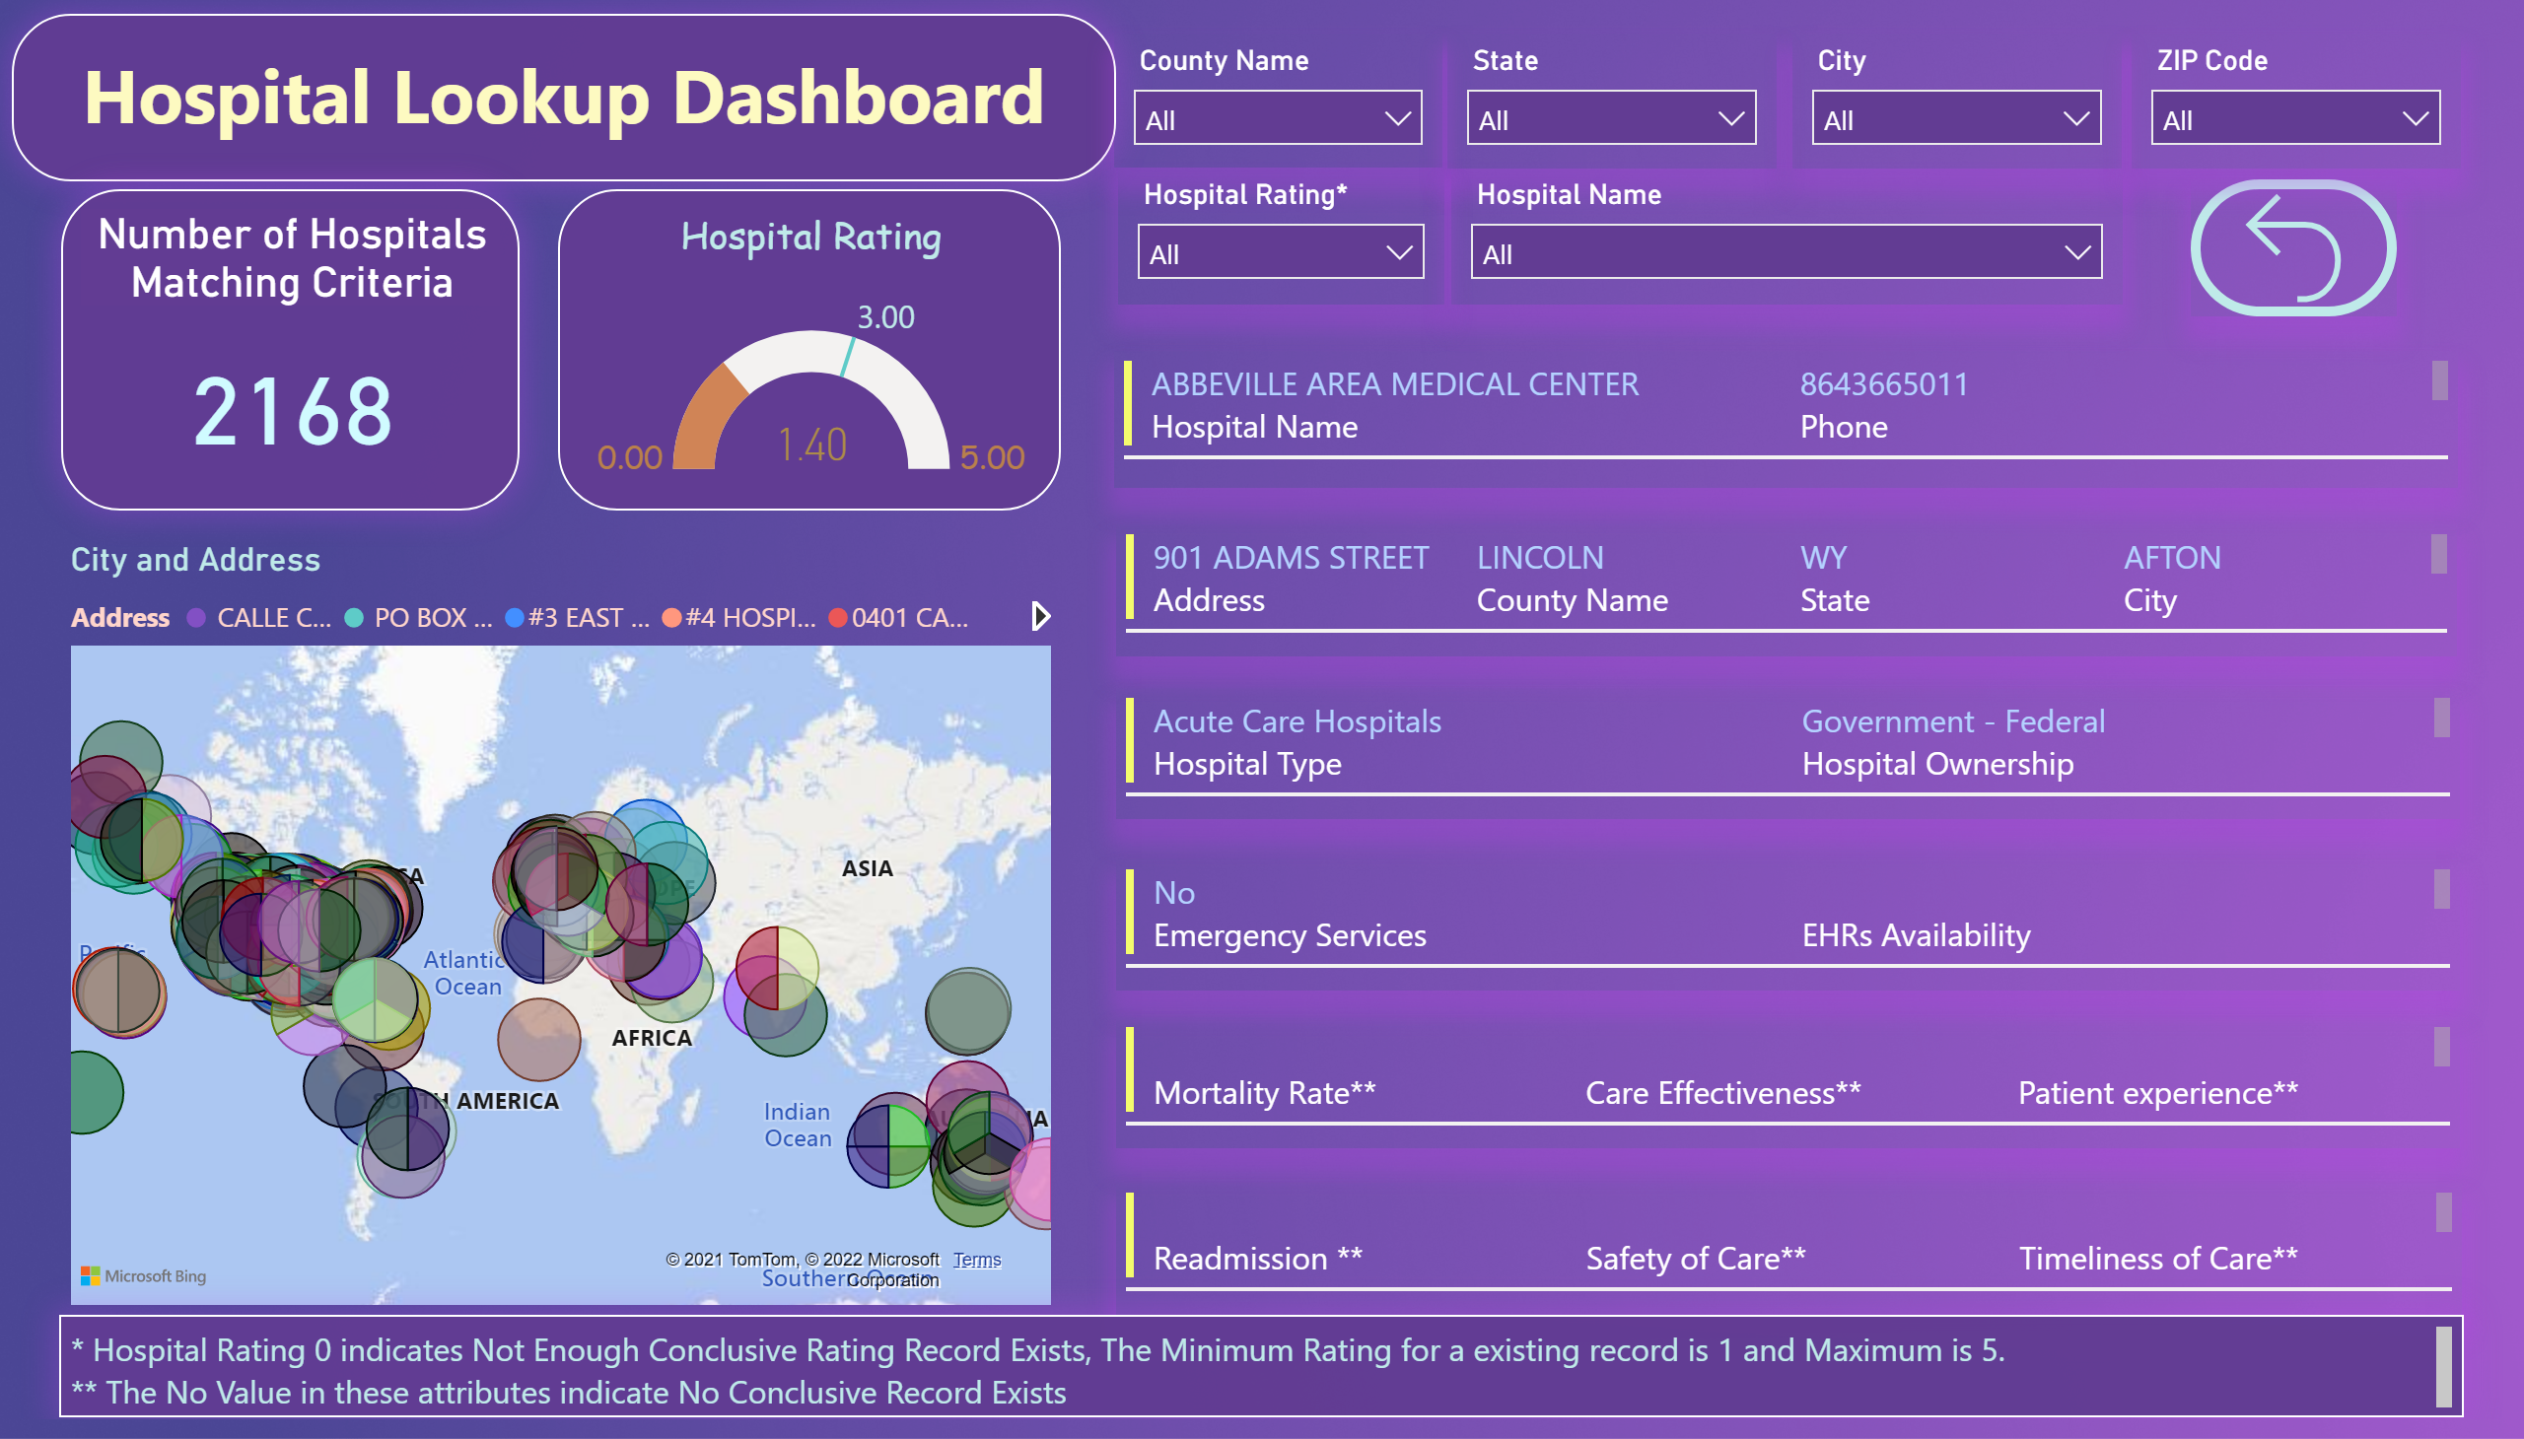
Hospital Report Card
Notes:
multiRowCard
No alt text provided
multiRowCard
No alt text provided
multiRowCard
No alt text provided
multiRowCard
No alt text provided
multiRowCard
No alt text provided
multiRowCard
No alt text provided
slicer
No alt text provided
slicer
No alt text provided
slicer
No alt text provided
slicer
No alt text provided
actionButton
No alt text provided
slicer
No alt text provided
slicer
No alt text provided
textbox
No alt text provided
Hospital Rating
No alt text provided
Number of Hospitals Matching Criteria
No alt text provided
map
No alt text provided
textbox
No alt text provided

